Slide 1
Kalman Filter based GPS tracking
Prepared by: Falak Shah (0BEC082)
Semester VIII (EC), Nirma University
Guided by: Mr. Ankesh Garg (DCTG-SAC/ISRO)

Slide 2
Table of contents
GPS overview
Signal structure of GPS
Acquisition
Tracking
Conventional tracking loop
Conversion from continuous to discrete domain
Kalman filter

Slide 3
Global positioning system: overview
Constellation of 24 satellites
Performance requirements of GPS systems
10-30 m accuracy
User dynamics
Worldwide coverage
Minimum number of required references for determining position in 3-D is 4
5 used to calculate user position out of 7 visible

Slide 4
Global positioning system: overview
Antenna
RF chain
ADC
Acquisition
Tracking
Ephemeris and pseudorange
Satellite position
User Position
Block diagram of GPS receiver

Slide 5
Signal structure of GPS
Coarse/ Acquisition (C/A code) and P codes
2 frequencies L1 centered at1575.42 MHz and L2 at 1227.6 MHz. (multiple of 10.23 MHz clock)
where S_{L1} is the signal at L1 frequency, A_{p} is the amplitude of the P code, P(t) and D(t) represent the phase of the P code and data code. f₁ is the L1 frequency, is the initial phase.
GPS signal phase modulated BPSK

Slide 6
Signal structure of GPS
P code and C/A code are bi-phase modulated at 10.23 MHz and 1.023 MHz Gold codes
C/A code generated with use of a LSR of length 10 and is 1023 bits long
1ms data enough to find its beginning
C/A codes generated and autocorrelation and cross correlation properties verified
Peak provides starting point of the code
Navigation data is 20 ms long- contains 20 C/A codes

Slide 7
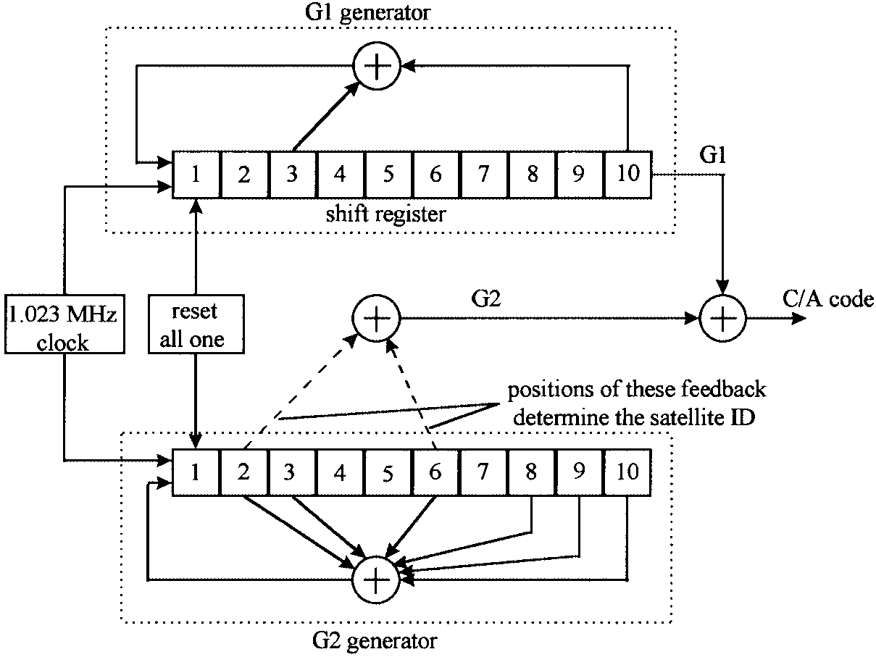
C/A code generator

Slide 8
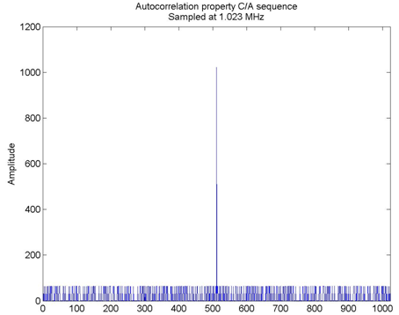
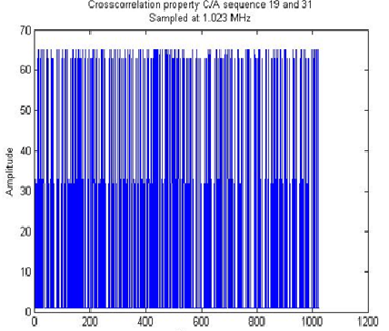
Autocorrelation and cross-correlation properties of C/A code

Slide 9
Acquisition
Search for frequency over is +/- 10 kHz which is maximum Doppler range
2-D search for carrier frequency and starting point of C/A code
IF is at 21.25 MHz, sampling frequency is 5 MHz. So, center of the signal is at 1.25 MHz.
Maximum data record used for acquisition is 10 ms since data is 20 ms long
Acquisition uses circular correlation for detection

Slide 10
Tracking loop
After acquisition- approximate carrier frequency and starting point of C/A code known
More accurate approximation by tracking
Continuously following the incoming carrier & code
Acquisition performed at regular intervals or on unlocking of loop
Maximum noise bandwidth, sampling time and damping factor are known
Loop gain parameters, filter coefficients calculated

Slide 11
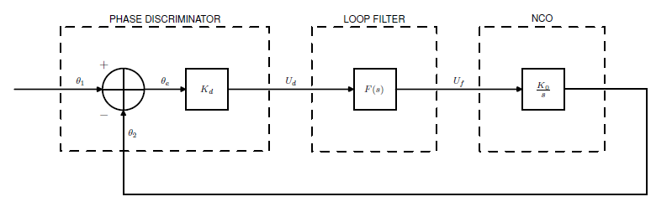
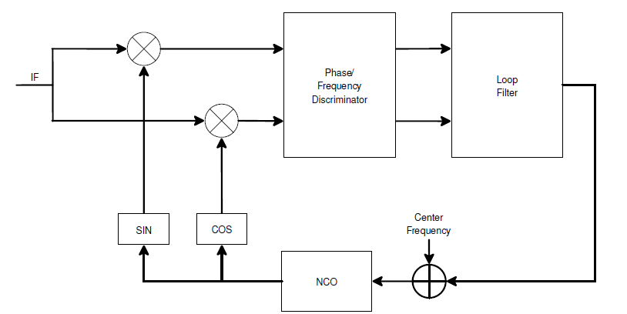
Tracking loop
Conventional tracking loop
Costas phase lock loop

Slide 12
PLL equations
Where k0 and kd are gain of discriminator and NCO respectively. F(s) being the loop filter transfer function given by

Slide 13
Continuous to discrete domain transforms
Bilinear transform and infinite impulse transform most commonly used
Convert individual blocks from continuous to discrete domain rather than complete digital design

Slide 14
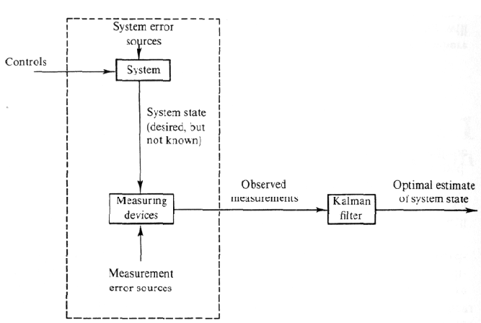
Kalman Filter

Slide 15
Kalman filter
Optimal recursive data processing algorithm
Optimal in all aspects- uses all measurements available regardless of their precision
Minimises statistical error by doing this
Recursive-does not need to keep all previous measurements in memory
Assumptions- linear system model with white and Gaussian noise
Whiteness- noise value not correlated in time & equal power at all frequencies
Gaussian- number of noise sources in system and measurement device so sum Gaussian

Slide 16
Review II

Slide 17
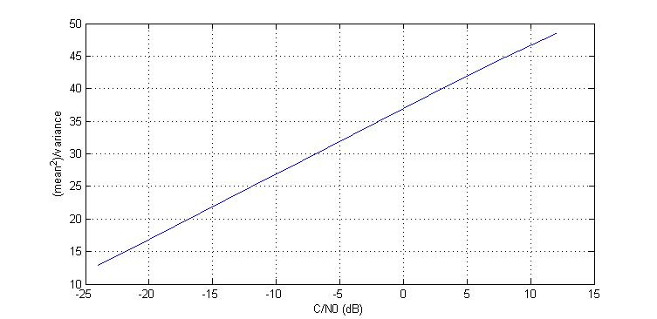
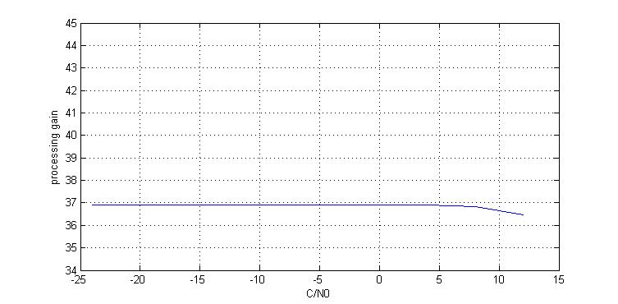
Gain due to Integrate and dump
Values of SNR (dB) after integrate and dump block and its constant processing gain value.

Slide 18
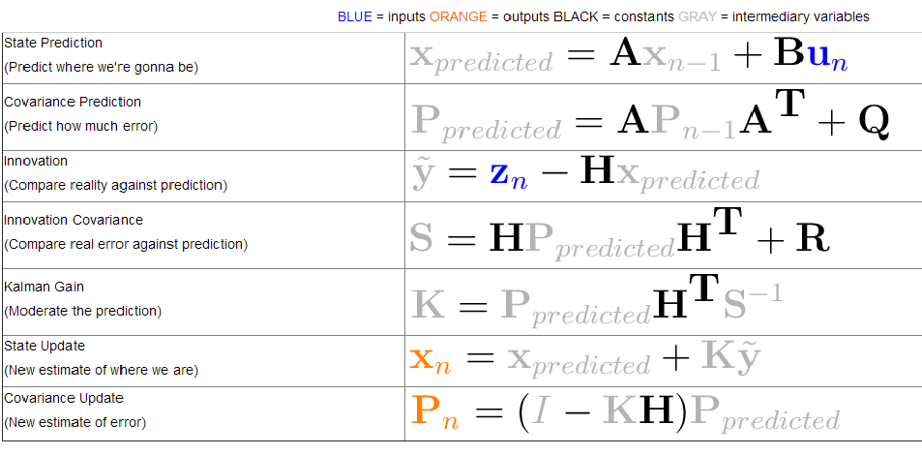
Kalman filter Equations

Slide 19
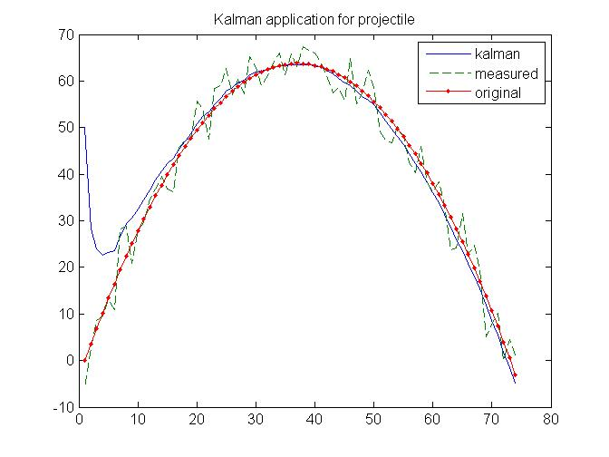
An example tested for Kalman filter
Test run for projectile motion
Measurements corrupted with noise provided with incorrect initial values yet tracking done
Role of parameters present in the equation understood

Slide 20
Formation of filter equations for PLL
Phase difference and frequency difference were selected to be the parameters for state equations
Requirements: Design of FLL, error variance in measurement of phase and frequency
Deciding the control inputs for the state equations
Finding variance for different values of C/N₀ which are 40 dB-Hz to 80 dB-Hz for GPS signals
Measurement matrix becomes [1 2*pi*T ;0 1] as per relation between and f.

Slide 21
FLL Design
Provides frequency difference between incoming and locally generated signals
Equation as follows:
atan2(dot,cross)/(t2-t1)
Where dot = IP₁ IP₂ + QP₁ QP₂
cross = IP₁ QP₂ − IP₂ × QP₁
This discriminator is optimal at low to high signal to noise ratios

Slide 22
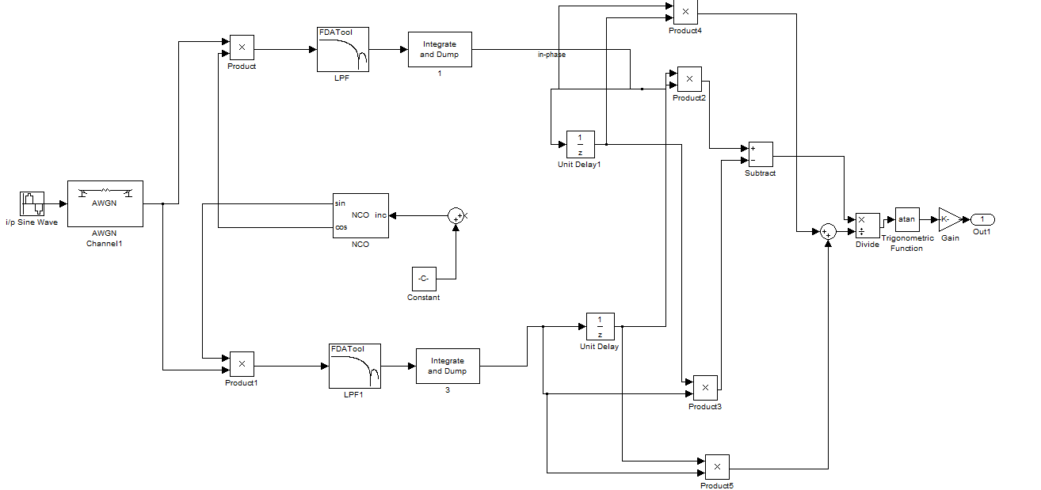
FLL Loop

Slide 23
Benefits of kalman filtering and costas loop
Loop is unaffected by sign change due to data bits due to use of division of in-phase and quadrature components
Limitation of low bandwidth of loop filter is overcome by using kalman filter.
Able to track even in case of high velocity users having high doppler frequency
Optimal estimate using all available measurements

Slide 24
Different Filter implementations
Smoother-Based GPS Signal Tracking in a Software Receiver, Mark L. Psiaki, Cornell University
Kalman Filter Based Tracking Algorithms For Software GPS Receivers, Mathew Lashley, Thesis, Auburn University
Above two implemented and innovation of change in input values done- desired output values obtained

Slide 25
Challenges in design
Non functioning of PLL due to divide by zero at
t=T as sine value dropped to zero
Kalman filter not showing any output values beyond first sample as first output came NaN (not a number)
Selection of values of error variance in measurement (open loop or closed loop)
State equation not producing desired output
Very high variance in FLL output

Slide 26
Solutions to design challenges
Addition of very small value (10e-6) to Quadrature phase component to prevent divide by zero error
Debugging to find reason for non functioning Kalman filter after first sample
Source found to be initial values of FLL set as zero causing NaN in output and the same loop iterations again and again
Initial values altered and output obtained
Error variance measured for closed loops

Slide 27
Solutions to design challenges
Process error variance and measurement error variance measured setting up high values for other
State equation used input as frequency difference output from FLL which failed to get desired output
So, difference of previous state of frequency and FLL output taken
FLL outputs averaged for decreasing variance

Slide 28
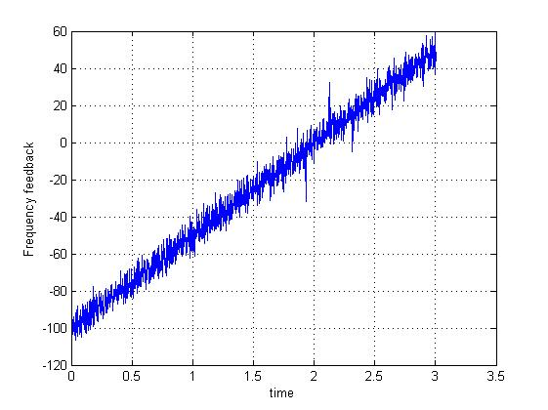
Results: Lock even in high dynamics

Slide 29
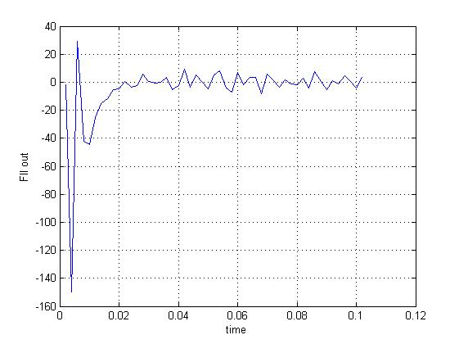
Results: Higher loop bandwidth and locking

Slide 30


Review III-Kalman filter based GPS tracking

Slide 31
List of Simulations carried out
PLL and FLL based on thesis by Matthew Lashley
PLL based on 2 papers by M L Psiaki - GPS Signal Tracking in high dynamics and low C/N₀
One innovation in design of FLL using different equations from those given in the papers
Cascading of Kalman filter
All simulations performed at 40 dB-Hz-at lower value of SNR than the average 45 dB-Hz for GPS signals
Test for signal outage and whether or not signal can regain phase lock

Slide 32
Kalman filter incorporation
Phase discriminator
Kalman filter
Loop filter
NCO to feedback

Slide 33
Matthew Lashley thesis
Equations
Just depends on previous state, no input values.
Test performed show it is able to maintain phase lock even after outage situation.

Slide 34
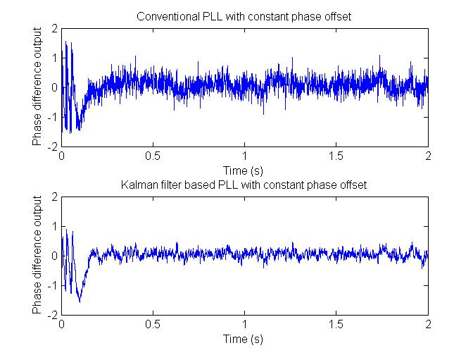
Comparison: discriminator output and kalman filtered output

Slide 35
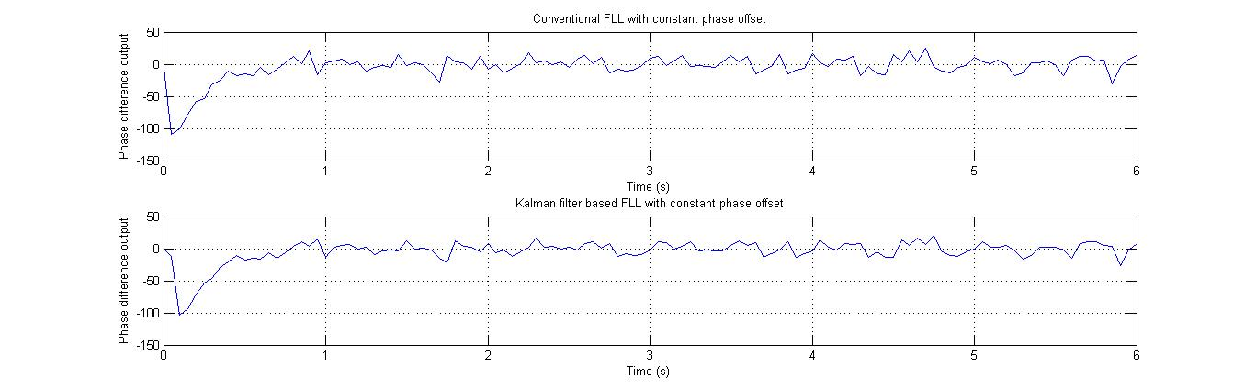
Another variant: Using frequency difference for feedback

Slide 36
PLL with 10 ms integration time in outage
Increased integration time improves gain of the integrate and dump block
Upper limit is 10ms due to data bit transition boundary
Filter coefficients modified as sampling time changed
Initially it was taken as 1 ms, now increased to 10 ms which increases gain to 47 dB from 37 dB.
Entire loop along with Kalman filter now works on 10 ms sampling time after integrate & dump
Improvement in PLL performance even in outage case as shown in results

Slide 37
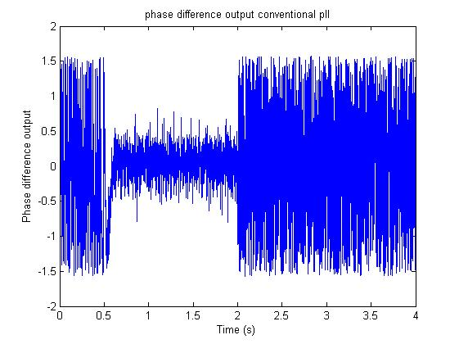
Coventional PLL: failure during outage

Slide 38
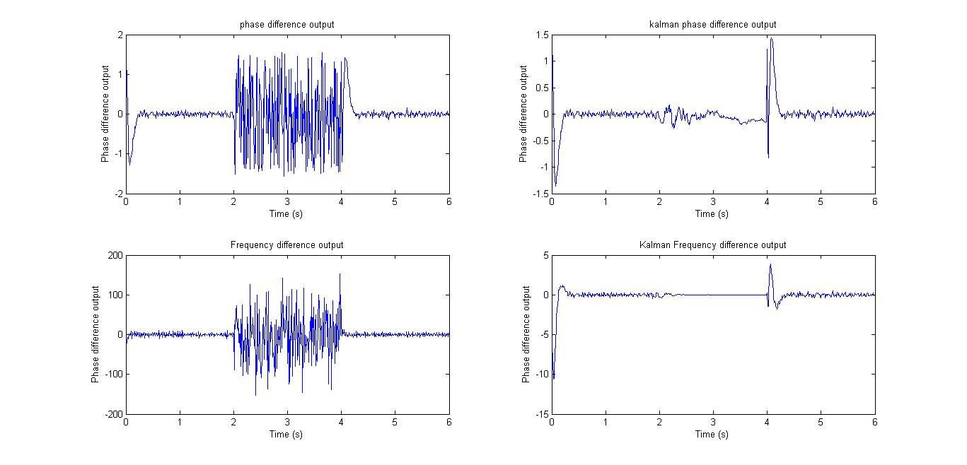
Outage case in PLL with kalman filter

Slide 39
How this works
Conventional PLL is not weighted and thus due to f_{d} being > f_{pullin} it loses lock during outage
Kalman filter being weighted filter it effectively neglects measurements during outage
It predicts the present state values based on the values just before signal outage occurs and thus maintains phase lock
Measurement error variance values increased during outage to make it neglect measurements
Process error variance nearly zero

Slide 40
Model 2: based on papers by M L Psiaki
Equations:
Locks frequency but cannot lock phase offset hence constant phase offset remains

Slide 41
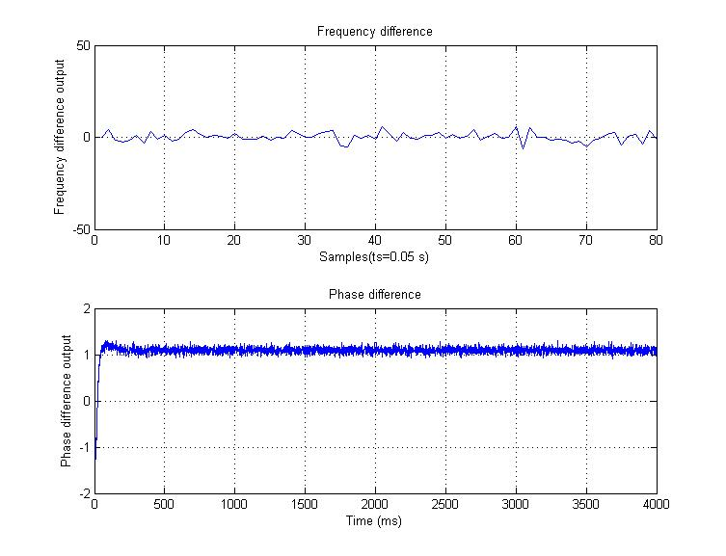
Results by use of the model

Slide 42
Cascade of kalman filters
Cascade tried for further reduction in noise error variance
Too much increase in computational complexity
One kalman filter block followed by other with reduced measurement error variance
Phase discriminator
Kalman filter
Loop filter
NCO to feedback
Second Kalman filter

Slide 43
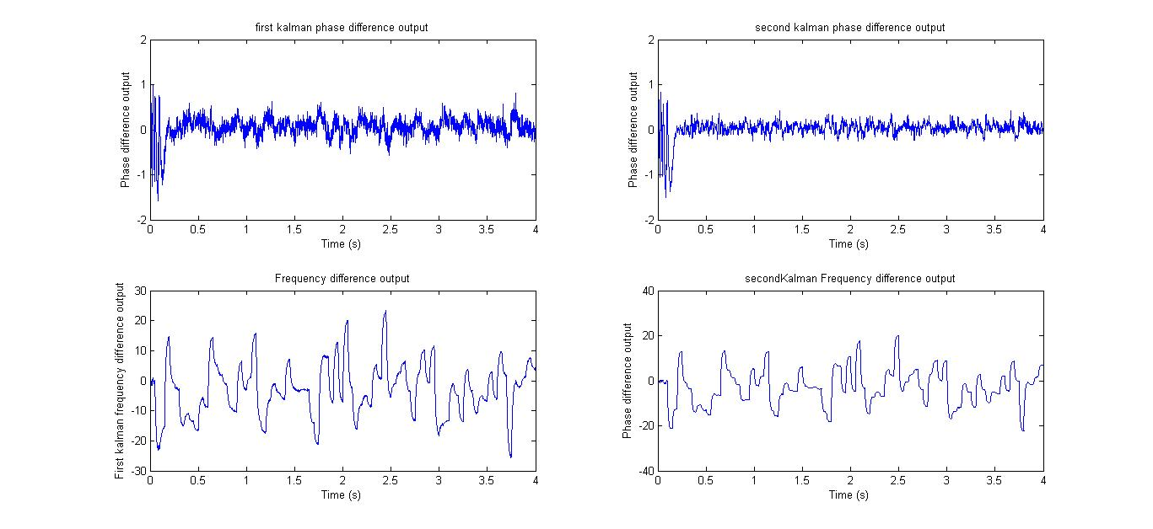
Results comparison

Slide 44
Conclusion
Criteria | Conventional PLL | K F based PLL
Constant phase offset | Tracks for any value | Tracks for any value
Constant frequency offset | Can track upto certain range (pull-in) | Can track upto much higher range than conventional
Frequency modulated signal | Can handle for very low dynamics | Can track high dynamics
Signal outage | Completely unlocks and cannot attain lock again | Attains lock immediately on re appearance of signal
Post signal outage | Re-acquisition required | No requirement of carrying out acquisition again
Measurement noise variance | Same amount as found in actual measurements | Reduction in variance by use of state equations

Slide 45
References
Fundamentals of Global Positioning System Receivers: A Software Approach, James Bao-Yen Tsui, John Wiley & Sons, INC.
Spilker, Jr., J. J. (1996a). Fundamentals of Signal Tracking Theory
Parkinson, B.W. (1996). Introduction and Heritage of NAVSTAR, the Global Positioning System, Volume 1, American Institute of Aeronautics and Astronautics, Washington, DC.
Improving Tracking Performance of PLL in High Dynamic Applications, Department of Geomatics Engineering, by Ping Lian November 2004
Thesis on Kalman Filter Based Tracking Algorithms For Software GPS Receivers, Matthew Lashley
Smoother-Based GPS Signal Tracking in a Software Receiver, Mark L. Psiaki, Cornell University
Extended Kalman Filter Methods for Tracking Weak GPS Signals Mark L. Psiaki and Hee Jung, Cornell University, Ithaca, N.Y.
Carrier tracking loop using adaptive two-stage kalman filter for high dynamics situation K H Kim, G I Jee and J H Song, International Journal of Control, Automation and Systems, Vol-6, Dec,2008

Slide 46

Thank You

Slide 47

On a lighter note…

